Slide 1
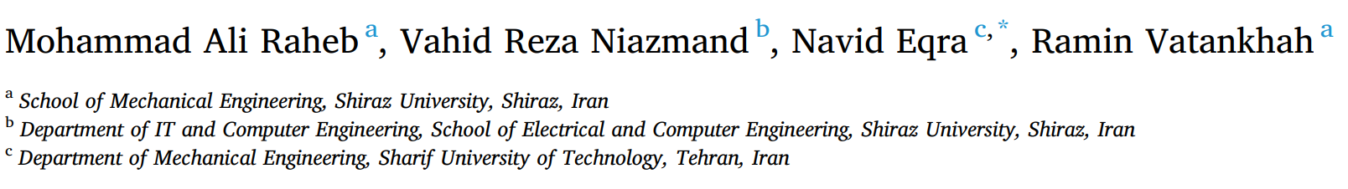
Subcutaneous insulin administration by deep reinforcement learning for blood glucose level control of type-2 diabetic patients

Slide 2
Background ---- Diabetes Mellitus
Type-1
Type-2
Autoimmunity against insulin-producing beta cells
Insulin Deficiency.
Insulin Resistance + Impaired Insulin Secretion
Control insulin
Tradition Treatment:
self-managed by patients through multiple glucose level measurements & insulin injection
Normalized advantage function (NAF) algorithm:
identify patient’s condition & help control blood glucose in optimal way
Insulin Doses
Food Intake
Blood Glucose Level

Slide 3

Research Problem and Challenge
Needs
Identify the patient’s condition
Help control the blood glucose level in an optimal way
Requirements
Automated control to increase precision and reduce human error
Prior Work | Existing Challenges
Usual: Self-manage by multiple glucose level measurements + administration of insulin | Ordeal
Traditional: PID | Respond fast enough to sufficiently control postprandial glucose without meal announcements
RL: DP (model free) | Enough data and samples to satisfy the system’s sample complexity & high-order simulator

Slide 4
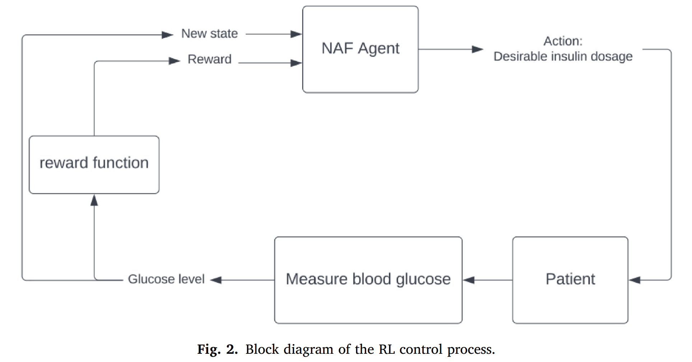
Methods—Reinforcement Learning Control
Reward Function
Q-learning Process
Glucose-insulin dynamics single delay model (SDM):
Average Virtual Patient (AVP)
----representative of the type-2 diabetic patient

Slide 5

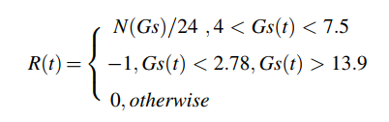

Q-Learning Process
Immediate rewards are valued and future rewards are devalued
State-action Function:
Reward Function
Fatal State
(avoid reaching)
Optimal Action:

Slide 6
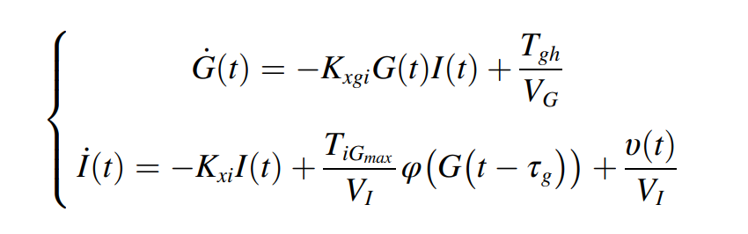
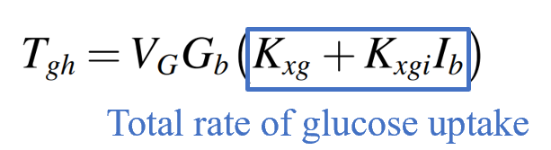
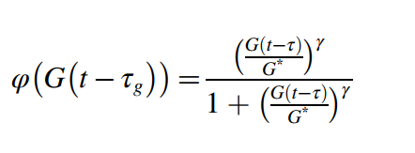
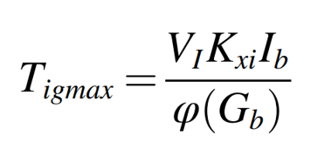
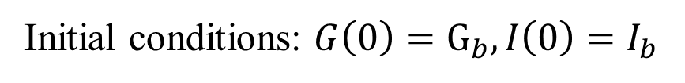
Learning Environment --Average Virtual Patient (AVP)
Meal Schedule
Input
Insulin Injection
Glucose-insulin Dynamics
insulin-dependent glucose uptake rate
Glucose Level
Insulin Level
Initial Glucose
Input Rate
external insulin
input rate
insulin naturally removed rate
the rate of insulin released
in response to the glucose level
Initial conditions: $G\left(0\right)=G_{b}, I\left(0\right)=I_{b}$
insulin secretion rate
as a function of glucose concentration.

Slide 7
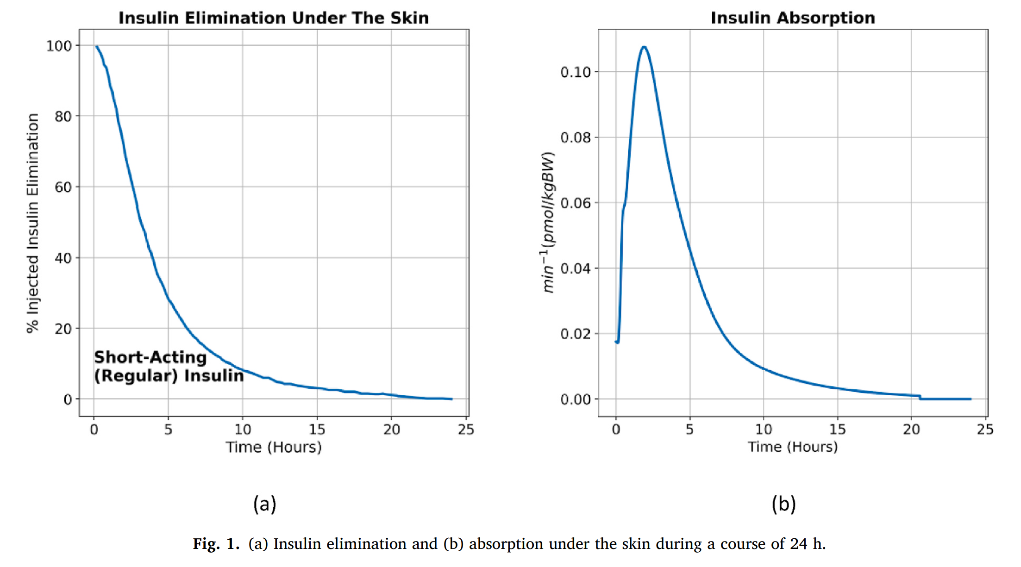
Example of insulin elimination (simulate absorption)
Time derivative

Slide 8
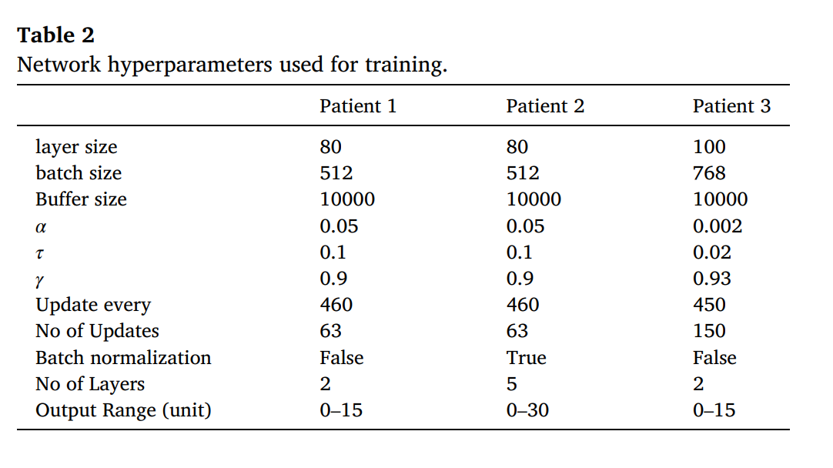
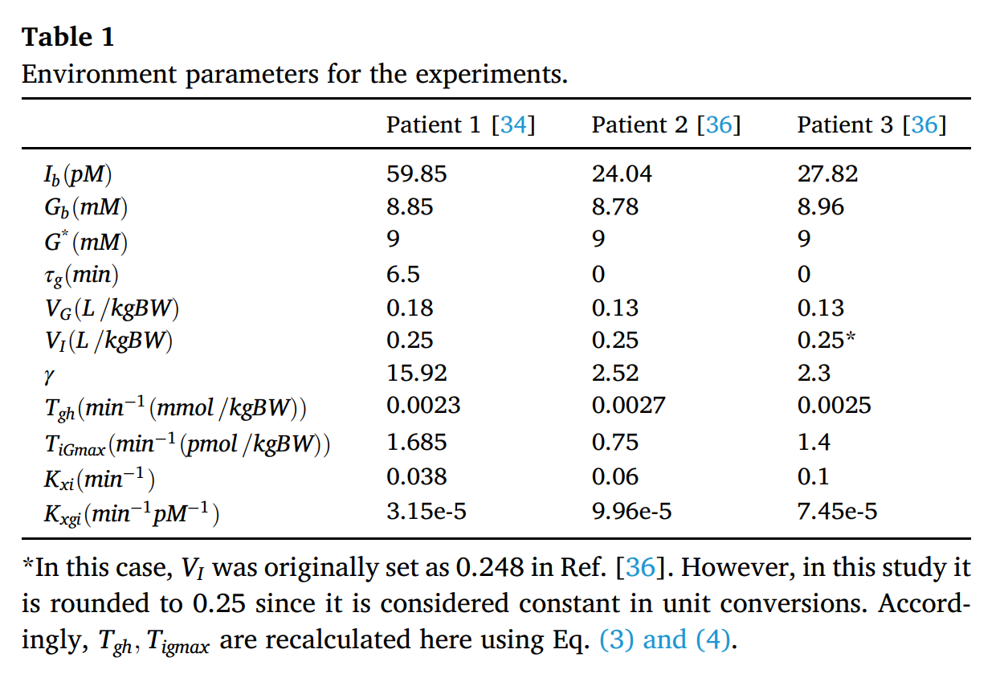
Research Data
Volume of the insulin need to be injected in each time frame to control the blood glucose level in the range [4, 7.5] (mM).

Slide 9
Setup of Model
The RL models are trained using ε-greedy exploration with ε = 0.9
Possibility = 0.9
Exploration
Action is chosen at random
Possibility = 0.1
Exploitation
Action is chosen based on Q value function.
Discover better actions that may not have been apparent from the initial observations.
The mean square error (MSE) loss of temporal difference predictions was optimized using the Adam optimizer.
learns from the difference between the predicted and the actual reward to optimize the predicted Q value of each state

Slide 10
Evaluation of Model
Set up 3 experiments with different sets of environment parameters
Three different virtual patients.
Glucose level set to 9,10,10.5 at 9:00 a.m., 1:00 p.m. and 9:00 p.m
Simulate 3 meals intake each day

Slide 11
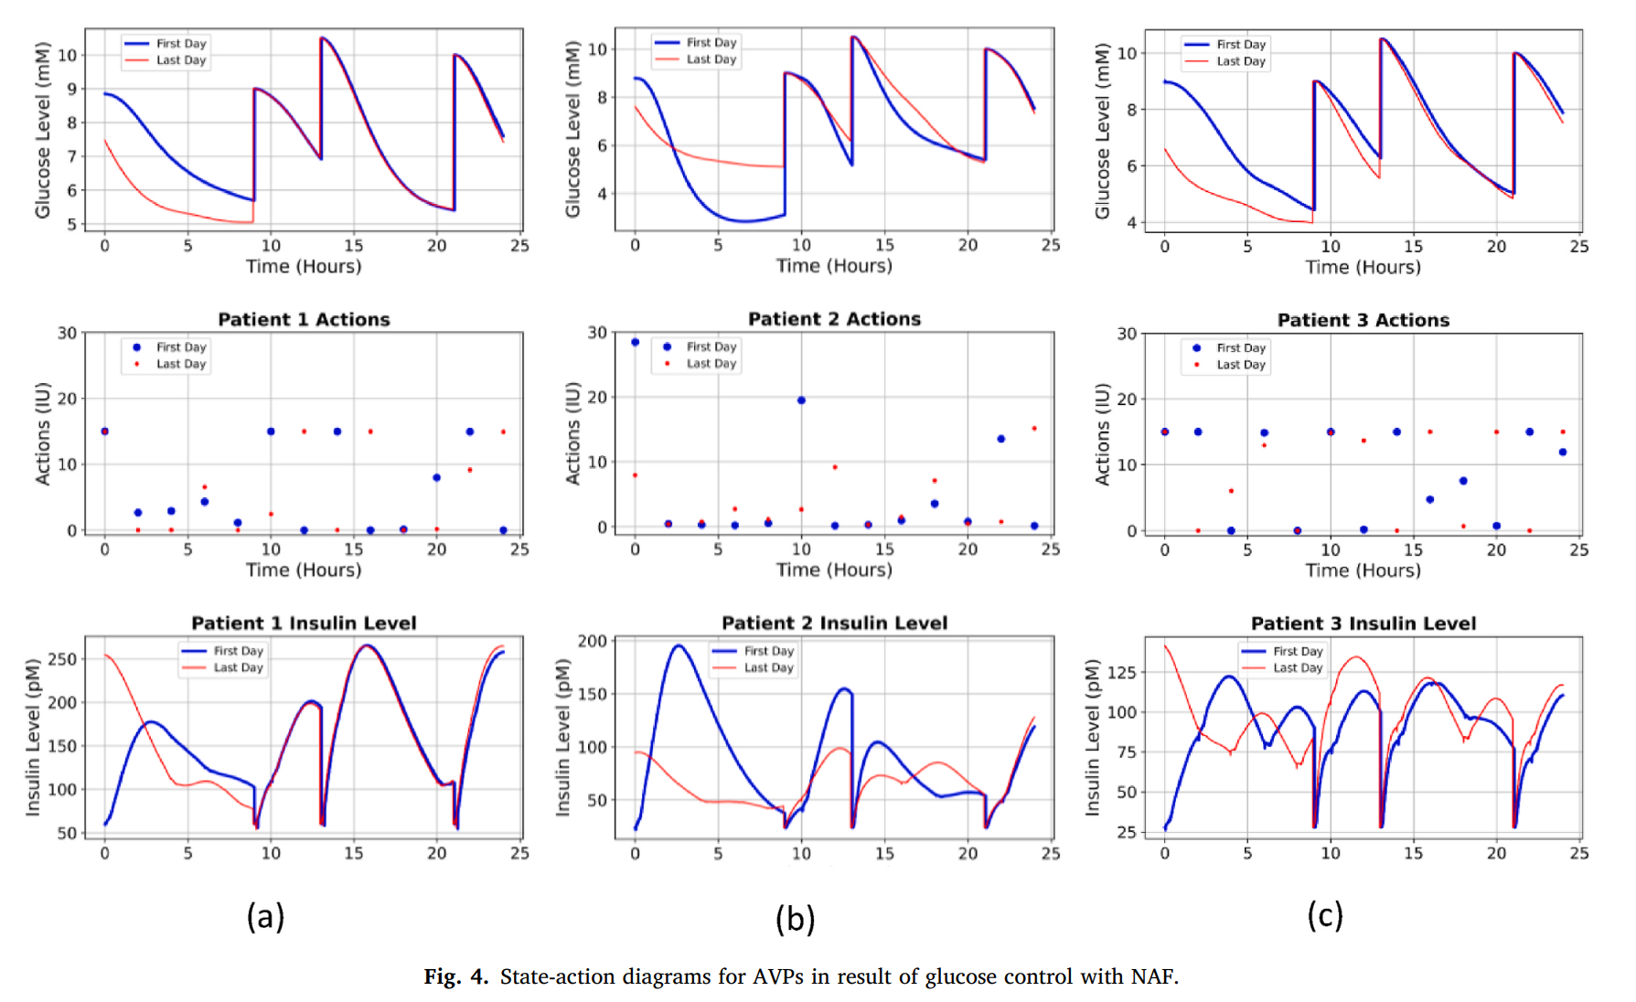
Result
The algorithm was able to keep the glucose level in the normal range
(apart from the times of meal intake)
The injected insulin successfully brought down the glucose level

Slide 12
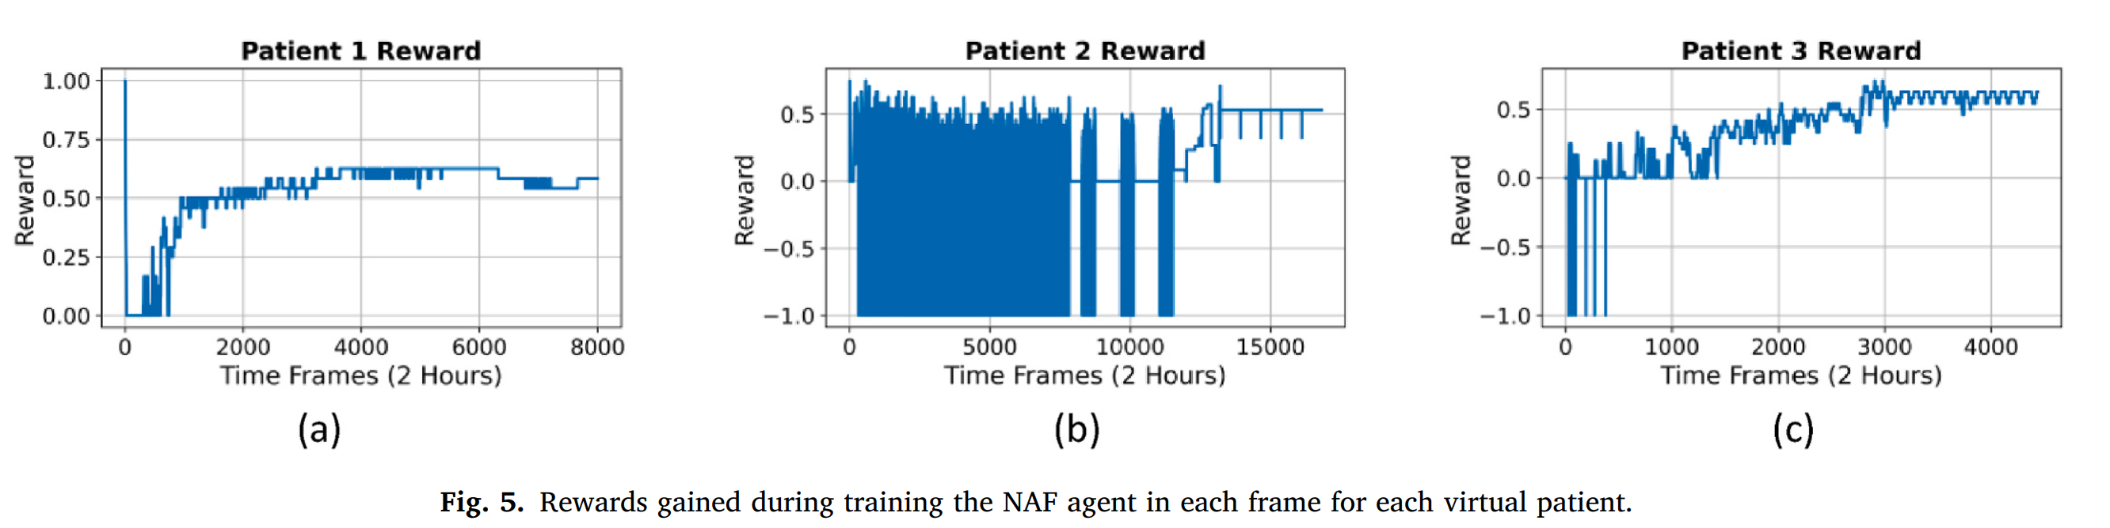
Result
It is evident that through exploration the agent was able to avoid fatal states and optimize the actions.

Slide 13
Contribution
Model-Free RL Algorithm ---- without expert knowledge of underlying dynamics or meal announcements, using only glucose level as input
Simple & practical reward function
Consider absorption dynamic of injected insulin
Reframes the problem from diagnosis-based to an action-based problem

